Slide 1
library(dplyr)
r-ladies_global %>%
filter(city == 'Chicago')
Wifi: Groupon Guest
Pwd: Gam3Plan!
Career Series Kick-off: Using R to Land the Job, a Resume Building Tutorial
Scarlett Winters
February 25, 2020

Slide 2
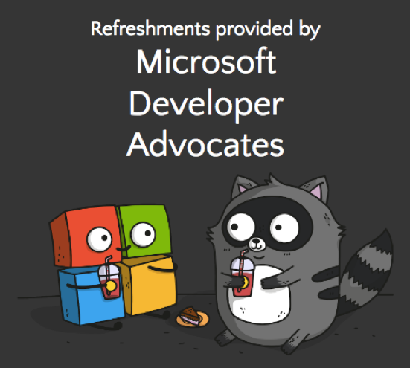

Tonight’s Agenda
6:00 - 6:30 pm > Getting settled in, food and drinks
6:30 - 6:45 pm > Intros & Announcements
6:45 - 7:30 pm > Pagedown Tutorial
7:30 - 8:00 pm > Hanging Out
Don’t forget to sign in at the front, or use this link: bit.ly/rladieschisignin
Live-tweet this event: @RLadiesChicago, #RLadies, #rstats

Slide 3
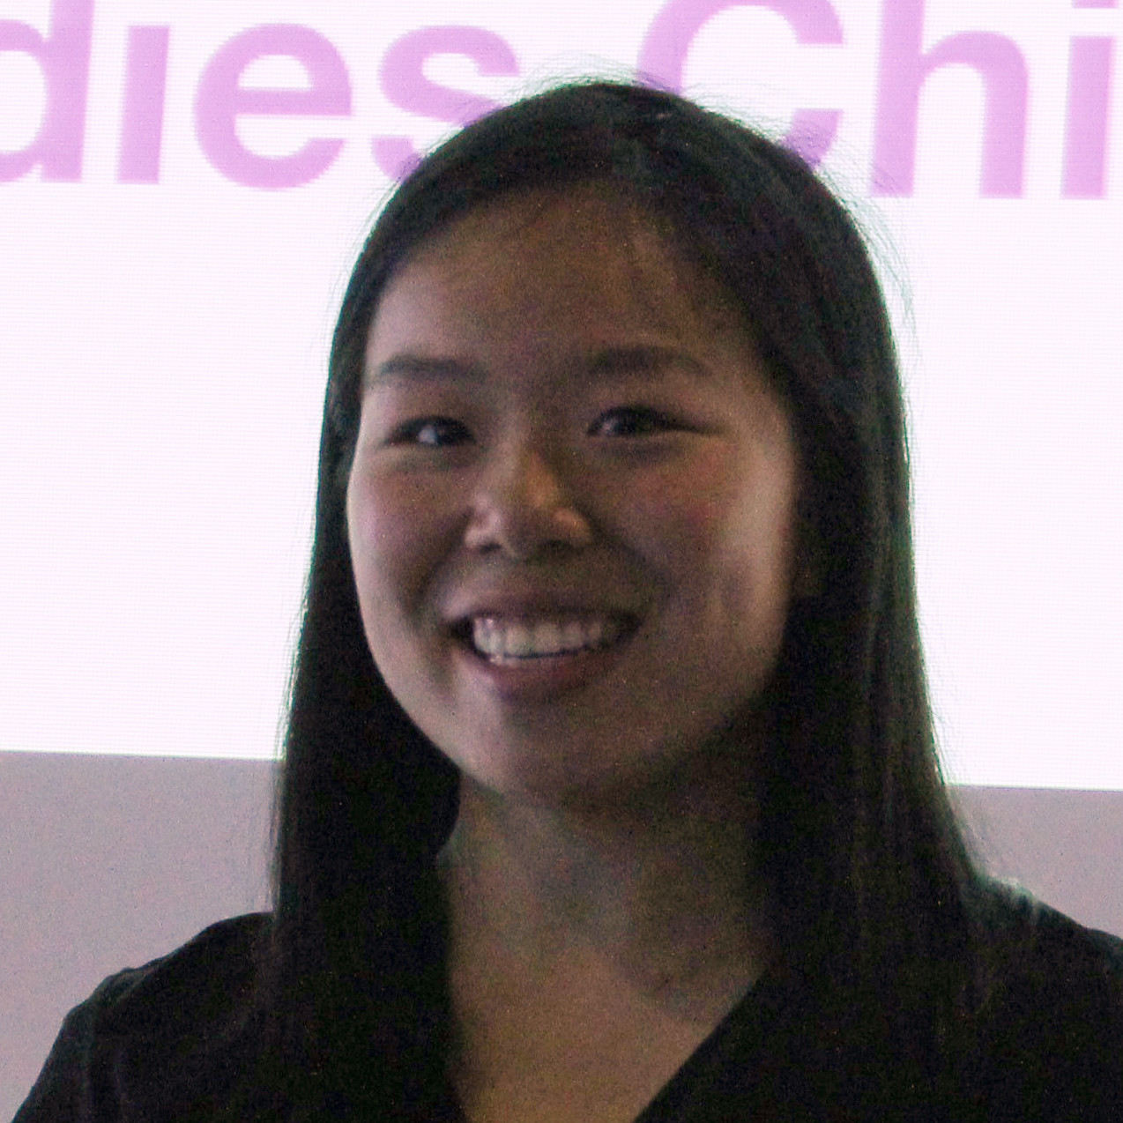
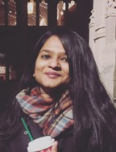

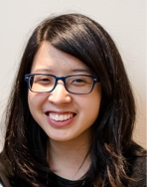
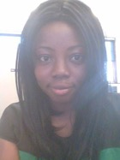
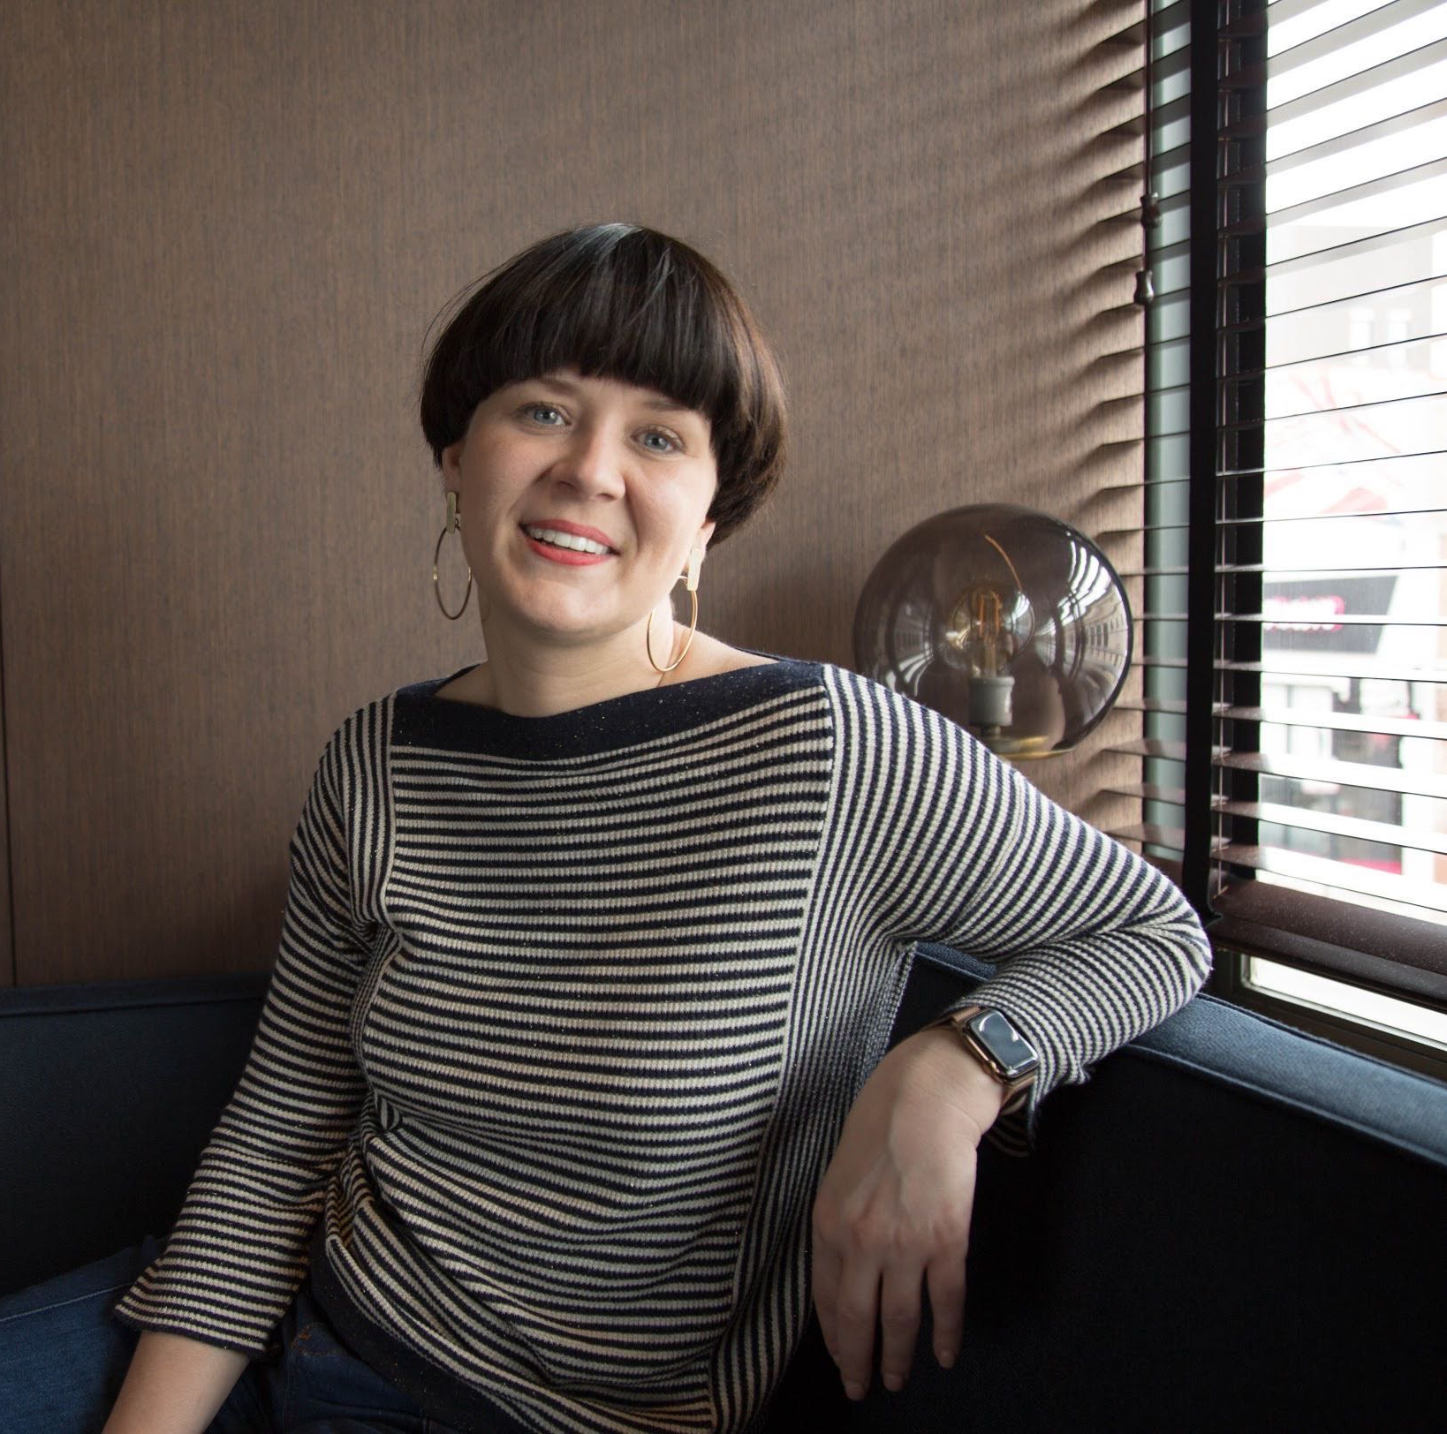
Hello!
We’re proud R-Ladies
We organize the R-Ladies Chicago Meetup.
You can find us at @RLadiesChicago on Twitter.
Angela
Sushmita
Ola
Kristi
Scarlett
Katherine

Slide 4

R-Ladies: 160+ Chapters & Growing!
Worldwide organization that promotes gender diversity in the R community via meetups and mentorship in a friendly and safe environment
Notes:
Our mission is to achieve proportionate representation by encouraging, inspiring and empowering the minorities currently underrepresented in the R community.

Slide 5
R-Ladies meetups
Code of Conduct
(taken from R-Ladies Global)
Find this online at: https://rladies.org/code-of-conduct/
R Consortium Code of Conduct: https://wiki.r-consortium.org/view/R_Consortium_and_the_R_Community_Code_of_Conduct
R-Ladies is dedicated to providing a harassment-free experience for everyone. We do not tolerate harassment of participants in any form.
This code of conduct applies to all R-Ladies spaces, including meetups, Twitter, Slack, mailing lists, both online and offline. Anyone who violates this code of conduct may be sanctioned or expelled from these spaces at the discretion of the Founding Members.
If you are being harassed by a member/guest/participant of/at R-Ladies, notice that someone else is being harassed, or have any other concerns, please contact the Founding Members via reporting@rladies.org.
Please email us at: chicago@rladies.org, or send us a direct message in our Slack group.
Notes:
Other guidelines (for allies): First and foremost, this is a space for women. Respect that, and let women speak first. Realize that your voice might overpower someone else.

Slide 6
R-Ladies Chicago Statement on Power & Privilege
While you are ALL very welcome, this is primarily a space for women and gender minorities. We urge you to be mindful in your participation. We all bring varying degrees of power to this space and we'd like to remind you to be cognizant of your own power, position and privilege. Please take the space you need to engage with the event, but also make space for others to do the same.
Notes:
First and foremost, this is a space for women. Respect that, and let women speak first. Realize that your voice might overpower someone else.

Slide 7
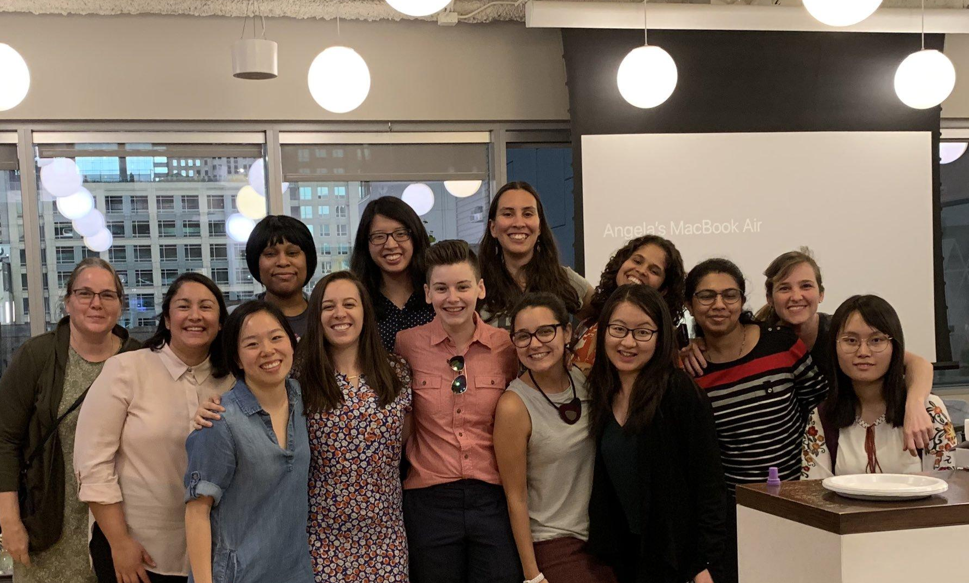
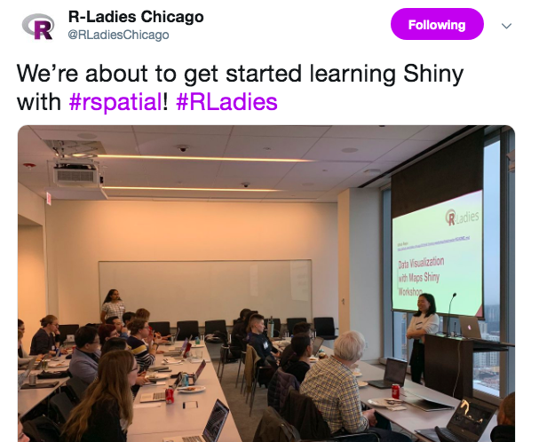
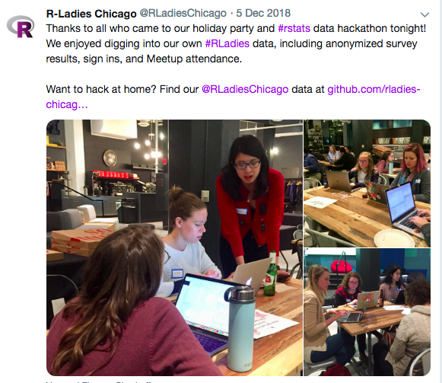
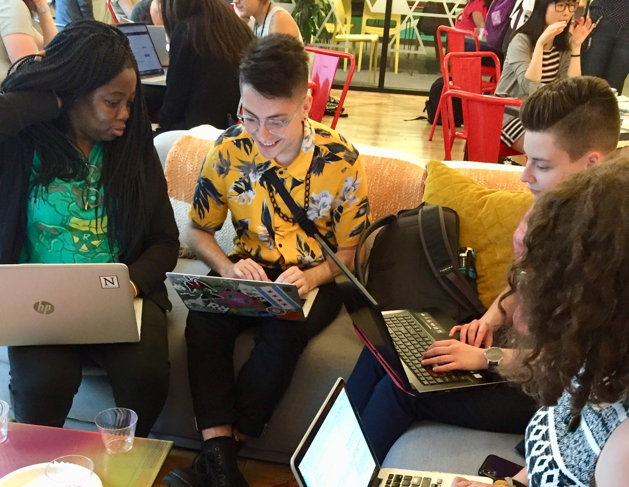
R-Ladies
Chicago
Number of R-LADIES
Events:
Tech talks
Interactive data hackathons
Social events
Study groups
Check us out on Twitter: @RLadiesChicago

Slide 8
Upcoming Events
#TidyTuesday Project Nights
Every Tuesday at Chi Hack Night @ Merchandise Mart
Part II: Our Best Resource is Each Other: A Q&A Panel on Developing Your Network and Learning from One Another
March 18, 6 pm @ Groupon
Part III: Keep Growing: Building and Maintaining Your Online Presence
April 22, 6 pm @ Groupon

Slide 9



Call for Proposals (all due Saturday!)
Women in Analytics Conference
June 3-5, 2020, Cleveland, OH
Call for speakers open! (due Feb 29)
Scholarships open! (due Mar 1)
R/Finance
June 5-6, 2020, UIC, Chicago
Call for papers open! (due Feb 29)
Women+ Data Science Symposium
April 27, 2020, MSU, East Lansing
Call for papers open! (due Feb 29)

Slide 10


Conferences in the Area
Women in Data Science (WiDS)
Roosevelt University’s Congress Lounge
Friday, March 6, 4:30-8 pm
widschicago.org
useR! 2020
St. Louis, MO
July 7-10
Early bird registration is now open!
user2020.r-project.org

Slide 11
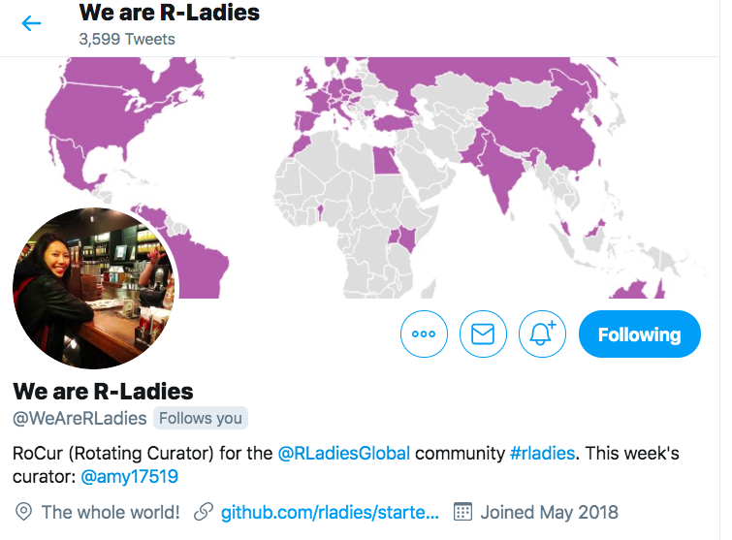
Volunteer Calls
Call for Curators - R-Ladies Rotating Curator Account
Looking for a new position? Want to increase your visibility?
Sign up here to curate (run by Katherine Simeon!)
R-Ladies Abstract Mentoring
Help other R-Ladies write great abstracts for conference submissions!
Sign up here to help out

Slide 12
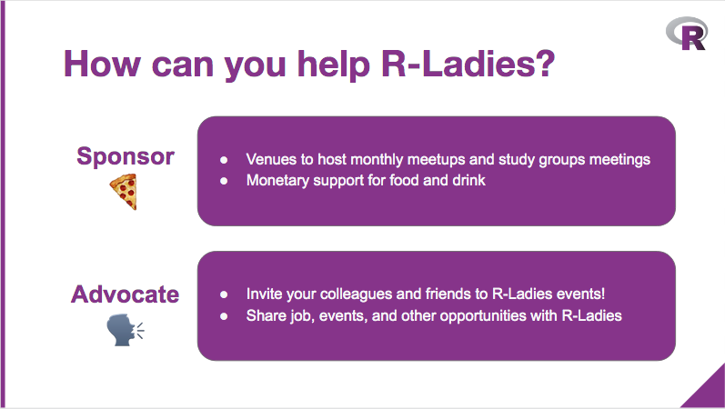

Slide 13
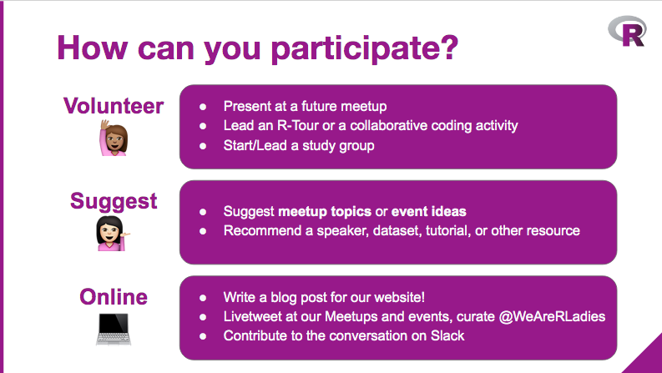

Slide 14
Connect with us!
Twitter: @RLadiesChicago
Website: rladieschicago.org
Email: Chicago@rladies.org
Slack Channel to communicate between Meetups
URL: https://rladiesinvite.herokuapp.com/
#r-hacks
#r-help
#jobs
#sg - study groups
#career_brunch_learn

Slide 15
Career Series Kick-off!

Slide 16
Why are we here?
Learn about a new and very useful R package
Prove to employers you know how to code in R from the get-go
Gain the skillset to navigate the data job market, just in time for hiring season
Notes:
Empowering diverse genders through career development

Slide 17
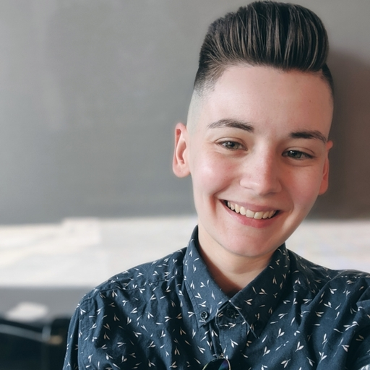
Who’s Scarlett?
Notes:
Scarlett Intro → what I do, why I’m doing this

Slide 18

What is Pagedown?

Slide 19
What is Pagedown?
Introduced @ rstudio::conf 2019
Authored by Yihui Xie and Romain Lesur

Slide 20
What is Pagedown?
RMarkdown executes markdown R code and prints the outputs.
Pagedown is a new R package which formats RMarkdown outputs into an HTML format, which can be printed into PDF.
Pagedown %>%
RMarkdown %>%
HTML %>%
PDF

Slide 21
What are we building?

Slide 22
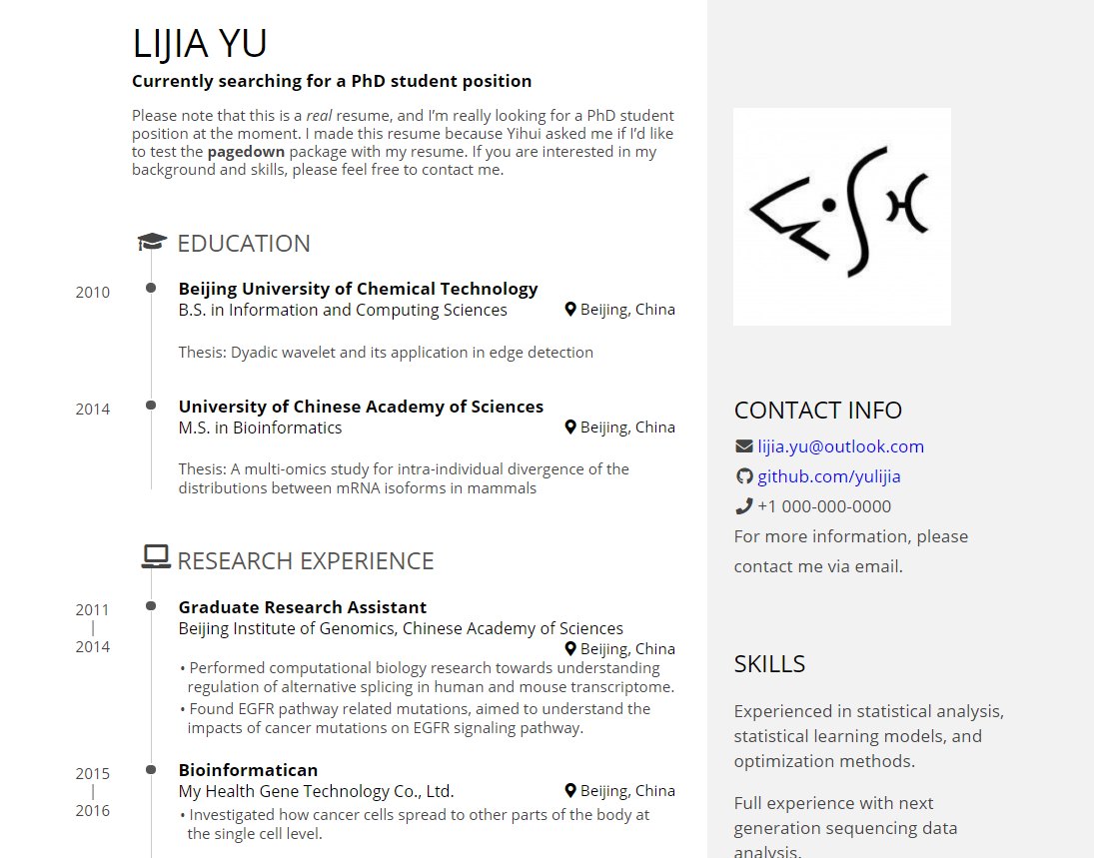

Slide 23
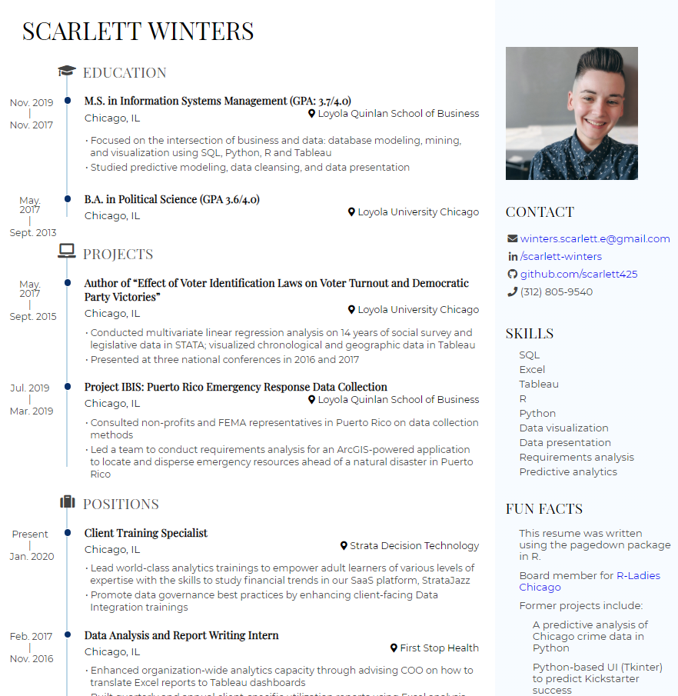
I followed Nick Strayer’s guide to enhance my pagedown experience.
Notes:
Still working through some hitches (i.e. chronological order using the data-driven format. Bear with me :)

Slide 24
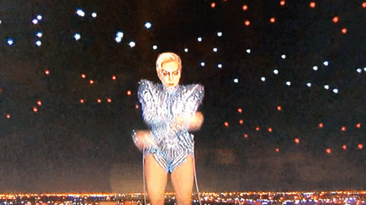
Let’s Dive In
Notes:
Necessary packages
How to access from File > New File > R Markdown > From Template
Anatomy of Pagedown
Plug & Play
How to print
Enhancements

Slide 25
Setting It All Up
Do you have Google Chrome installed?
Do you have R and RStudio installed?
Note: Pagedown requires a recent version of Pandoc (>= 2.2.3). Please install RStudio version (>= 1.2.1335), which has bundled Pandoc 2.x, otherwise you need to install Pandoc separately.
remotes::install_github('rstudio/pagedown')
Notes:
This is a newer package, so it is recommended we install remotely from Github.

Slide 26
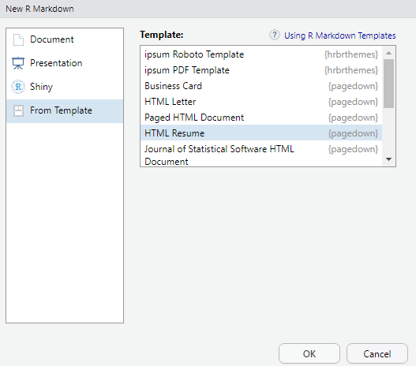
Navigation
File > New File > R Markdown > From Template
So many options to choose from, but we’re building a resume today!

Slide 27
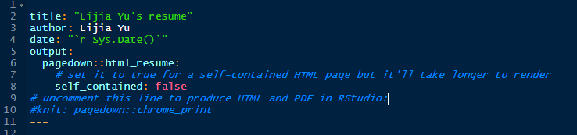
The default resume template is already filled out. Pagedown allows us to plug & play with our own resume info. But what does this header even mean?
Notes:
Pagedown:: → Output can be html_resume, business card, poster, etc.
Self_contained → produces a stand-alone HTML output. I have found this isn’t necessary.
Knit: Newer rollout. Necessary for output to print into Chrome.

Slide 28
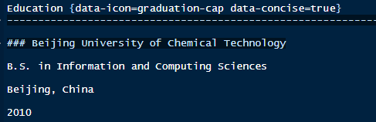
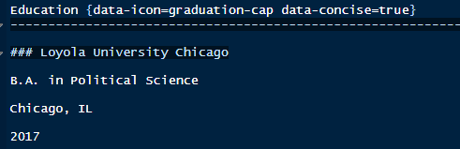
Plug & Play
Noteworthy:
data-concise = true
{data-icon}
Notes:
concise=true allows for inputs of 2 or more lines
{data-icon} adds an icon next to your resume header. Options include suitcase, laptop, and graduation cap

Slide 29
Wrapping Up
Today we learned how to build a 21st century resume using our favorite programming language!
Join us for Part 2 of our Career Series on March 18, right here at Groupon!

Slide 30
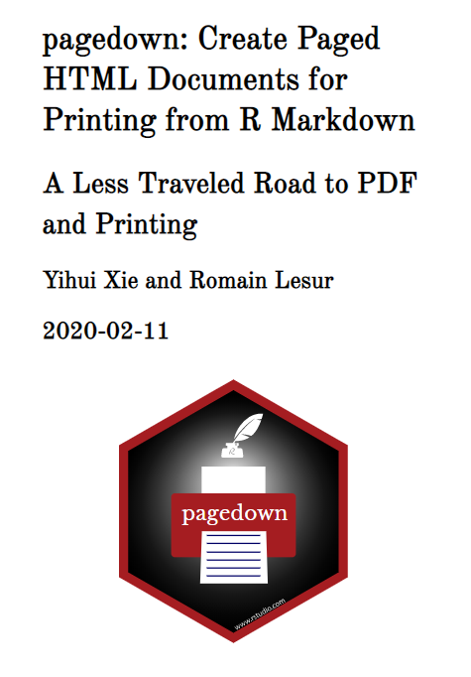
More Reading
rstudio::conf 2019 slidedeck
Pagedown package documentation
Nick Strayer’s “Building a Data Driven CV with R”
RStudio’s pagedown Github repo

Slide 31
One Last Thing...

Slide 32
Career Consulting Services!
I am launching my Career Consulting Services business!
5+ years of career consulting experience
Career consulting offerings for diverse genders and LGBTQ+ folks navigating the tech space.
Resumes
Cover Letters
Interview prep
Salary negotiation
Rates are flexible + sliding scale

Slide 33
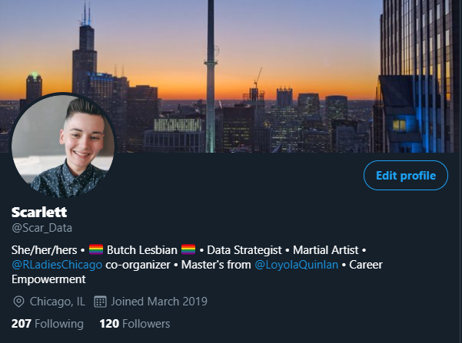
Thank You!
Connect with me on Twitter @Scar_Data or LinkedIn
winters.scarlett.e@gmail.com

